Slide 1
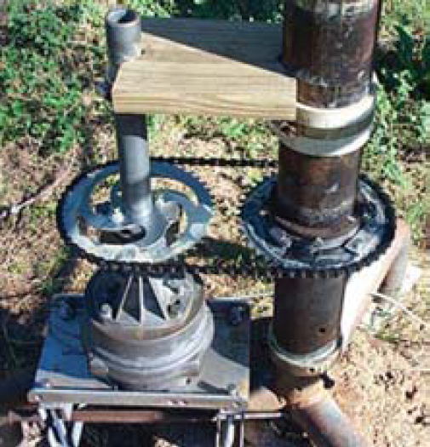
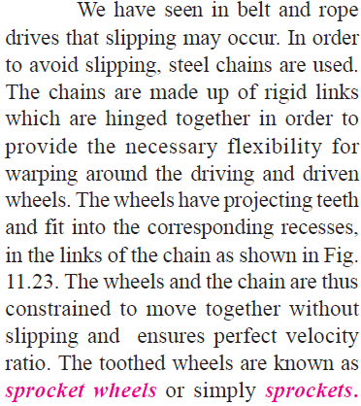
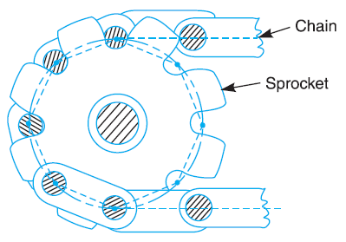
Theory of machines Wessam Al Azzawi
Friction:
Chain and sprocket

Slide 2
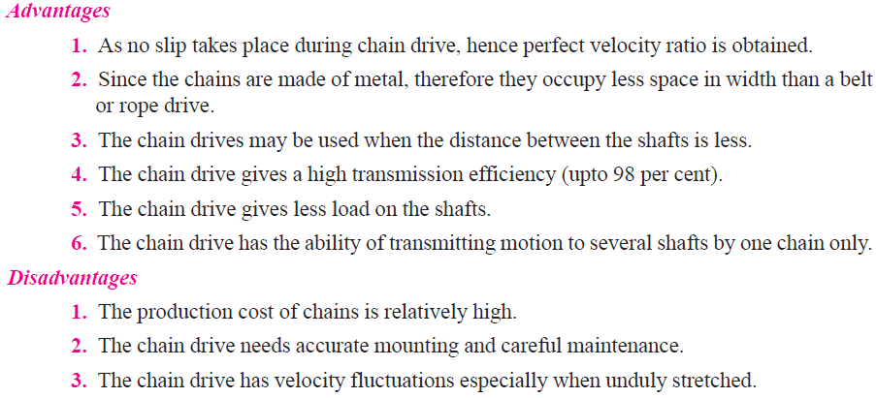
Theory of machines Wessam Al Azzawi
Friction:
Chain and sprocket

Slide 3
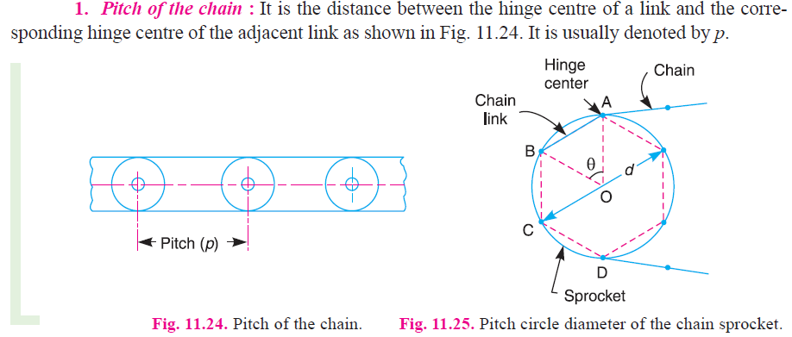
Theory of machines Wessam Al Azzawi
Friction:
Chain and sprocket

Slide 4
Theory of machines Wessam Al Azzawi
Friction:
Chain and sprocket

Slide 5
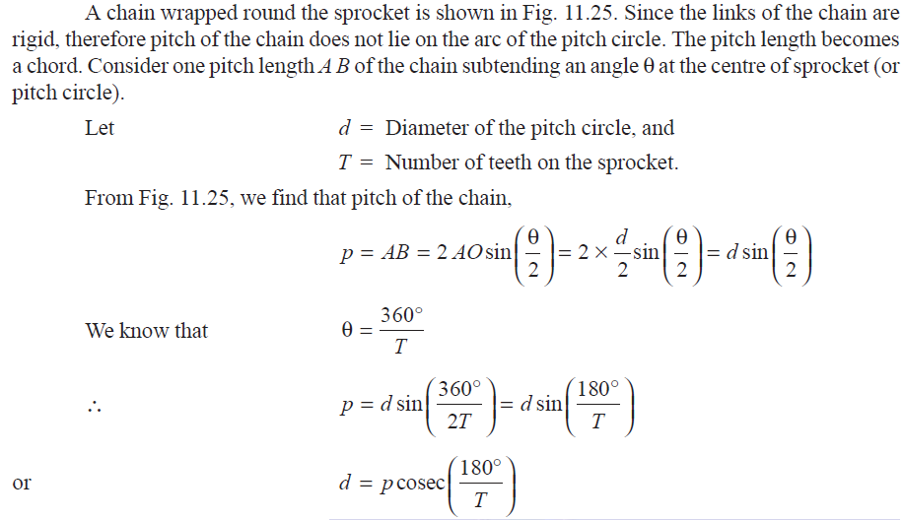
Theory of machines Wessam Al Azzawi
Friction:
Chain and sprocket

Slide 6
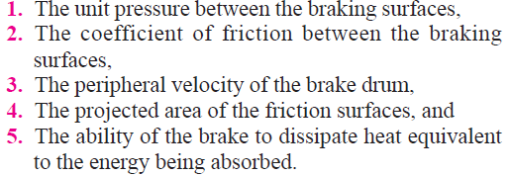
Theory of machines Wessam Al Azzawi
Friction:
Brakes
A brake is a device by means of which artificial frictional resistance is applied to a moving machine member, in order to stop the motion of a machine.
The energy absorbed by brakes is dissipated in the form of heat.
The capacity of a brake depends upon the following factors :
The major difference between a clutch and a brake is that a clutch is used to keep the driving and driven member moving together, whereas brakes are used to stop a moving part or control its speed.

Slide 7
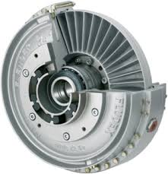
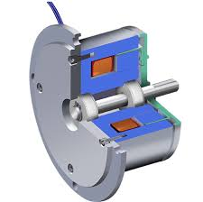
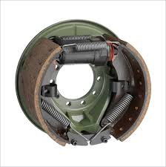
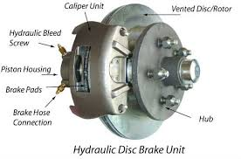
Theory of machines Wessam Al Azzawi
Friction:
Brakes

Slide 8
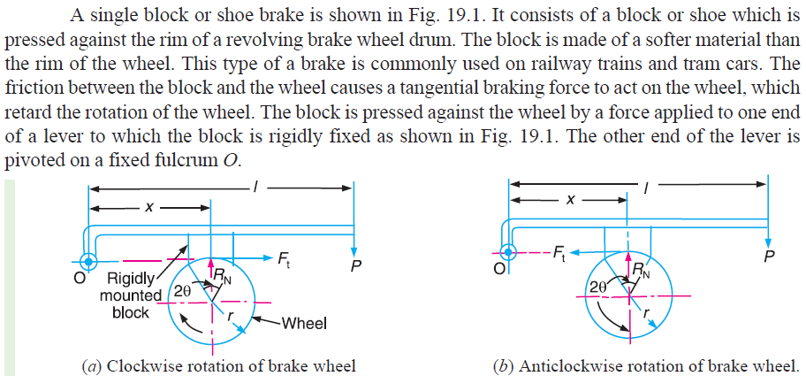
Theory of machines Wessam Al Azzawi
Friction:
Brakes

Slide 9
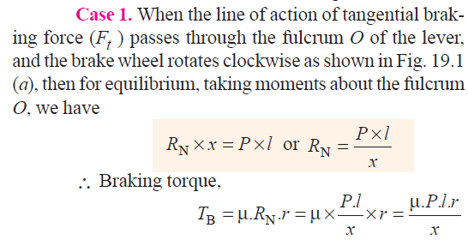
Theory of machines Wessam Al Azzawi
Friction:
Brakes
when the brake wheel rotates anticlockwise as shown in Fig. 19.1 (b), then the braking torque is same, i.e.

Slide 10
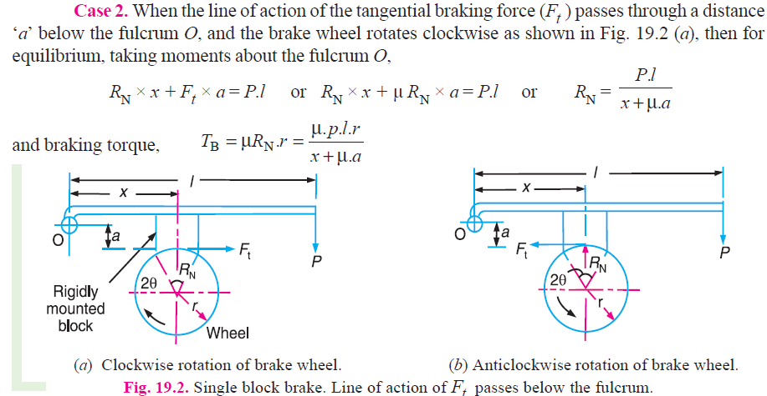
Theory of machines Wessam Al Azzawi
Friction:
Brakes

Slide 11
Theory of machines Wessam Al Azzawi
Friction:
Brakes

Slide 12
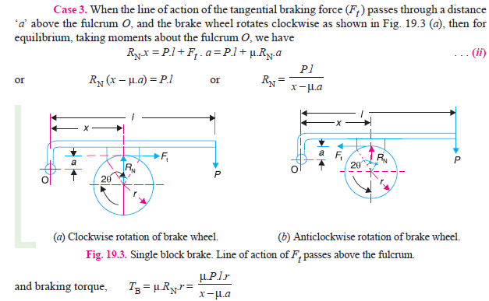
Theory of machines Wessam Al Azzawi
Friction:
Brakes

Slide 13
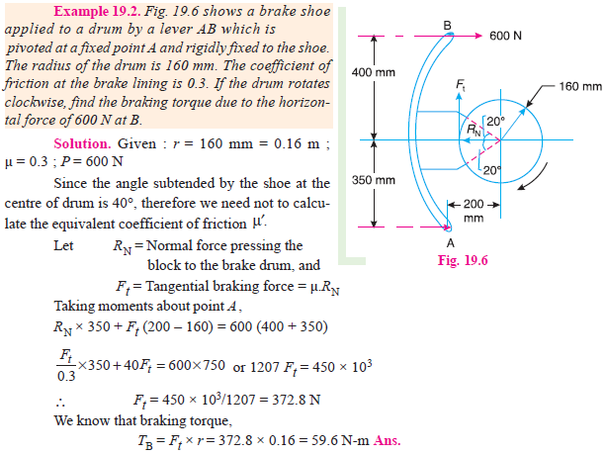
Theory of machines Wessam Al Azzawi
Friction:
Brakes

Slide 14
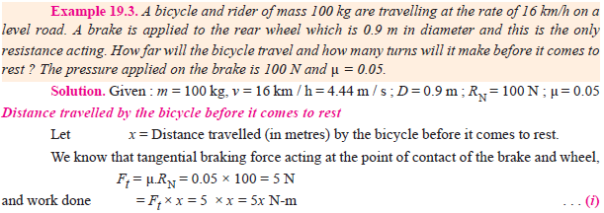
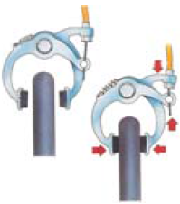
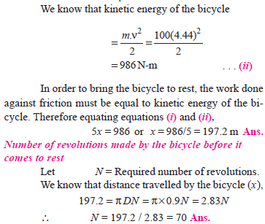
Theory of machines Wessam Al Azzawi
Friction:
Brakes

Slide 15
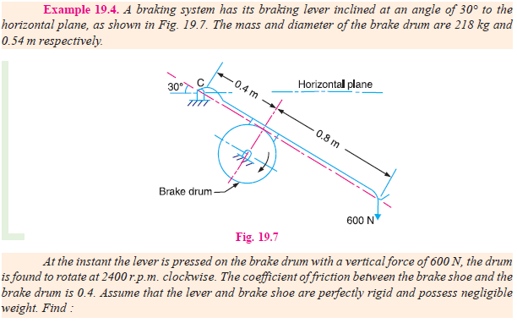
Theory of machines Wessam Al Azzawi
Friction:
Brakes

Slide 16
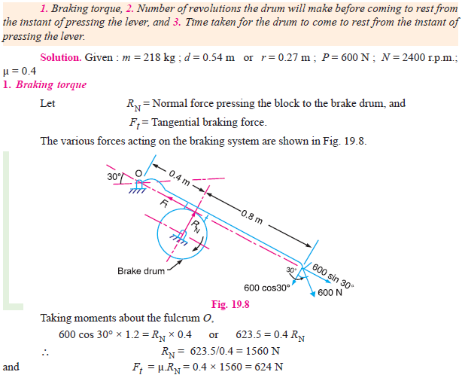
Theory of machines Wessam Al Azzawi
Friction:
Brakes

Slide 17
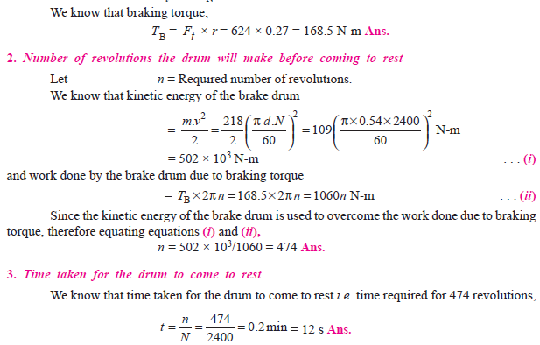
Theory of machines Wessam Al Azzawi
Friction:
Brakes

